Slide 1
Object-Oriented Metrics
Instructor: Mehroze Khan

Slide 2
Object-Oriented Metrics
CK Metrics
Proposed by Chidamber and Kemerer
Class-based metrics
LK Metrics
Proposed by Lorenz and Kidd
Class-based and operation-based
MOOD Metrics
Proposed by Harrison, Counsell, and Nithi
Class-based

Slide 3
CK Metrics
CK metrics, also known as Chidamber and Kemerer metrics, are a suite of object-oriented metrics designed to assess the quality of software design, particularly for object-oriented systems.
These metrics help in identifying design flaws and predicting the maintainability, reliability, and reusability of a system.

Slide 4
CK Metrics
Weighted methods per class (WMC)
WMC is the sum of complexities of all methods within a class.
If every method has a complexity of 1, WMC is simply the count of methods in the class.
They do not specify the specific complexity metric to use (e.g., cyclomatic complexity).
High WMC indicates a high level of functionality and complexity, which may make a class harder to understand, test, and maintain.
WMC should be kept low.
Example: Suppose a Customer class in an e-commerce application has methods like addToCart, removeFromCart, checkout, and updateProfile. If each method is of equal complexity, and there are four methods, WMC = 4.

Slide 5
CK Metrics
Weighted methods per class (WMC)
WMC is a predictor of how much time and effort is required to develop and maintain the class. The higher the value, the more effort required.
A large number of methods also means a greater potential impact on derived classes, since the derived classes inherit the methods of the base class.
Search for high WMC values to spot classes that could be restructured into several smaller classes.

Slide 6
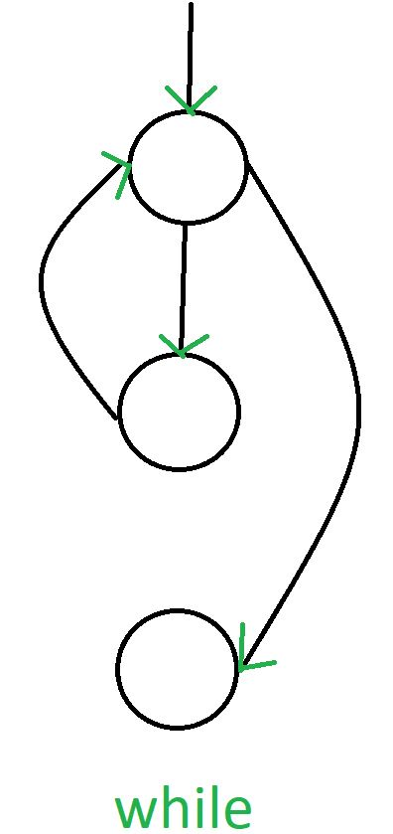
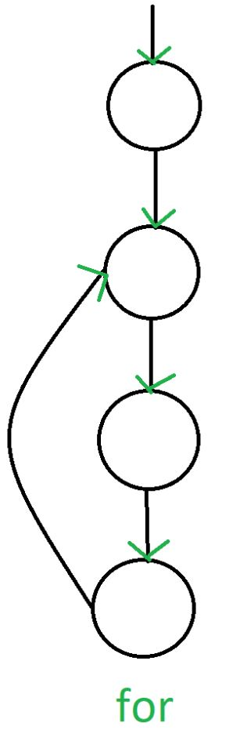
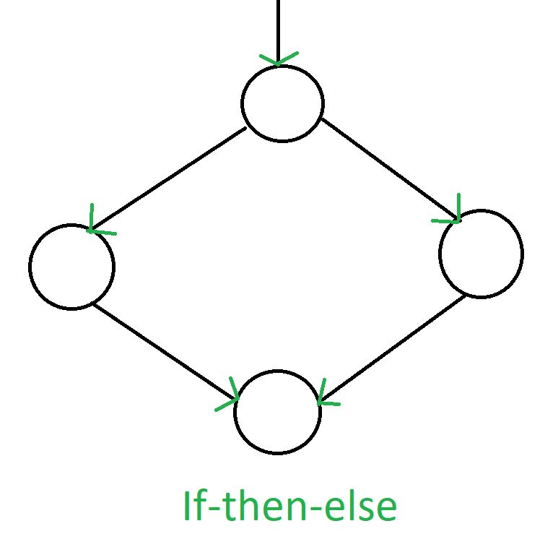
Control Flow Graphs

Slide 7
Control Flow Graphs
Program
Control Flow Graph
1

Slide 8
Cyclomatic Complexity
Cyclomatic Complexity is the quantitative measure of the number of linearly independent paths in it.
It is a software metric used to describe the complexity of a program.
Complexity is computed as:
Cyclomatic complexity V(G) for a flow graph G is defined as
V(G) = E − N + 2
where E is the number of flow graph edges and N is the number of flow graph nodes.

Slide 9
Cyclomatic Complexity
1
Cyclomatic Complexity:
V(G) = 10 edges − 10 nodes + 2 = 2.

Slide 10
White Box Testing Control Flow Testing
1
There are two independent paths:
Path 1: 1-2-3-4-5-6-8-9-10
Path 2: 1-2-3-4-5-7-8-9-10

Slide 11
CK Metrics
Depth of inheritance tree (DIT)
DIT is the length of the longest path from a given class to the root class in the inheritance hierarchy.
As DIT increases, the lower classes in the hierarchy inherit a greater number of data and methods, thus making their behavior more difficult to understand and causing testing to require more effort.
A large DIT value implies greater design complexity, but also greater reuse.
Example: Consider a class hierarchy where Animal is the root class, Mammal inherits from Animal, Dog inherits from Mammal, and Bulldog inherits from Dog. Here, Bulldog has a DIT of 3.

Slide 12
CK Metrics
Number of children (NOC)
NOC is the number of immediate subclasses inheriting from a particular class.
Higher NOC values suggest more complexity, as the class must support more inheriting classes.
High NOC can be a sign of over-generalization or it may indicate that a class is designed for extensibility.
Example: Suppose we have a Shape class, and three classes inherit from it: Circle, Square, and Triangle. Here, NOC for Shape is 3.

Slide 13
CK Metrics
Coupling between object classes (CBO)
CBO measures the number of other classes to which a given class is coupled, either by using their methods or properties.
High coupling makes the code less modular and harder to maintain or test, as changes in one class may impact other classes.
Example: If a Customer class in a banking application calls methods from Account, Loan, and Transaction classes, CBO for Customer would be 3.

Slide 14
CK Metrics
Response for a class (RFC)
The number of methods that can potentially be executed in response to a message received by an object of a given class.
RFC = M + R
M = number of methods in the class
R = number of remote methods directly called by methods of the class
As the RFC value increases, testing effort and design complexity also increase.
RFC should be kept low.

Slide 15
CK Metrics
Lack of cohesion in methods (LCOM)
Lack of Cohesion in Methods (LCOM) measures how closely related the methods in a class are, based on the instance variables (attributes) they access.
One common approach to calculate LCOM is based on method pairs, which calculates cohesion by examining how frequently methods share attributes.

Slide 16
CK Metrics
Lack of cohesion in methods (LCOM)
Identify pairs of methods.
For each pair:
Count it as "connected" if they access at least one common attribute.
Count it as "disconnected" if they do not share any attributes.
Calculate LCOM as follows:
LCOM = Number of disconnected method pairs − Number of connected method pairs
If LCOM is positive, it indicates a lack of cohesion (i.e., methods are disconnected).
If LCOM is zero or negative, the class has good cohesion.

